Slide 1




AI for Healthcare
NeuroPredict AI
Predicting Alzheimer's Progression from Longitudinal Brain MRI
Team Name
Zerox
Team Members
Steve Sony
Roshan Thomas Mathew
Sanjo K Siby
Vismey Sen
College / Institution
IIIT Kottayam
College Of Engineering Chengannur
Amal Jyothi
GEC Barton Hill

Slide 2
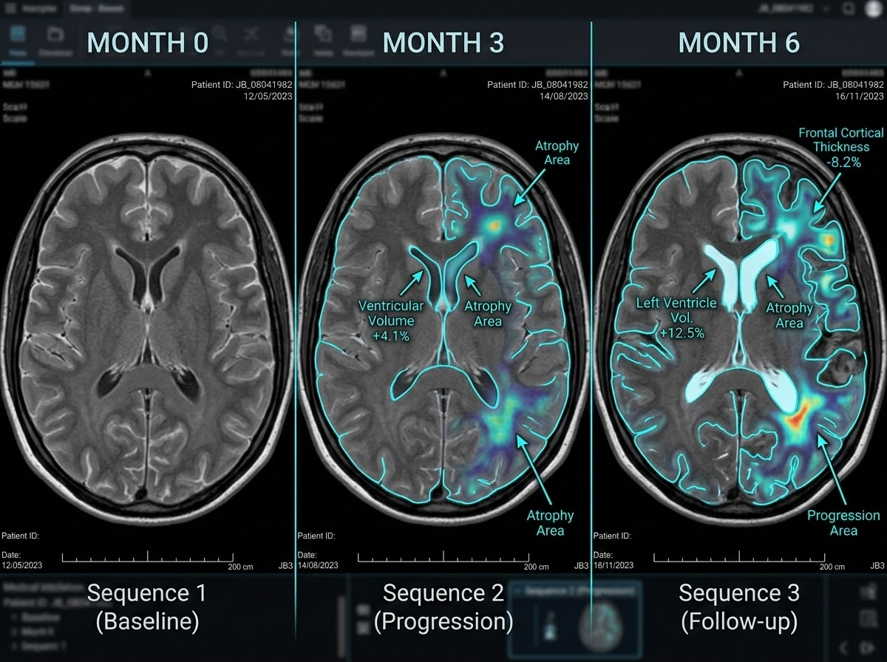

Alzheimer's Progression is a Problem of Time, Not Just a Single Snapshot
Multi-Visit Sequence Visualization
Single Snapshot Analysis
Conventional MRI analysis relies on a single snapshot, missing the dynamic nature of disease progression.
Longitudinal MRI Tracking
Alzheimer's evolves over time, requiring repeated observations to track structural brain changes.
By utilizing longitudinal datasets, we shift focus from isolated scans to tracking pattern changes across multiple visits.
Provides clinicians, researchers, and care teams with crucial structural change details for enhanced monitoring.
Note: This tool analyzes structural patterns and does not replace clinical diagnosis.
Sequential MRI Observation: Quantifying ventricular expansion, atrophy area mapping, and cortical thickness change across Month 0, Month 3, and Month 6.

Slide 3

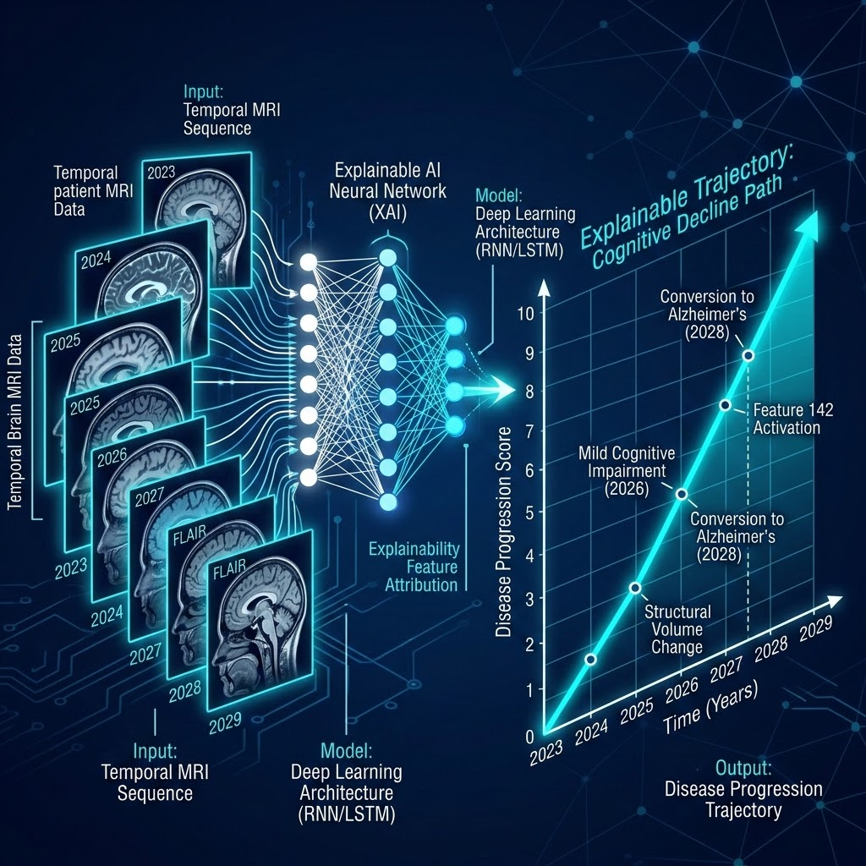
NeuroPredict AI
Mapping MRI Snapshots to an Explainable Progression Trajectory
SYSTEM ARCHITECTURE
Solution Pipeline & Modeling
Multiple MRI Snapshot Processing
Ingests longitudinal scan sequences from a single subject across distinct time points.
Brain Representation Extraction
Extracts high-dimensional anatomical features and isolates subtle structural changes.
Longitudinal Feature Comparison
Compares visit-to-visit variations to identify disease progression dynamics.
Temporal AI Risk Estimation
Learns temporal sequence patterns to forecast disease trajectory over time.
Clinical Decision Support
Serves as an interactive tool to track structural evolution rather than an autonomous diagnostic system.
CLINICAL OUTPUTS
Explainable Progression Metrics
Longitudinal Risk Trend Line
Replaces static binary classification with a continuous temporal progression curve.
Explainability & Feature Attribution Maps
Provides visual highlight overlays pinpointing regions driving the progression risk.
Visit-to-Visit Structural Comparisons
Quantifies chronological volume change and biomarker shift across scans.
VISUAL XAI PIPELINE
Temporal MRI Sequence → Deep XAI Network → Progression Score

Slide 4
A Robust Pipeline Powered by 3D CNNs and Temporal Modeling
End-to-End Longitudinal Dementia Progression Risk Prediction
01 / DATASET
OASIS-2 Dataset
Our prototype leverages the OASIS-2 Longitudinal Dementia dataset.
Enables multi-visit tracking and temporal evaluation of structural brain changes over extended clinical studies.
02 / PIPELINE
Preprocessing
Standardized sequential preprocessing pipeline:
Quality checking & spatial registration
Skull stripping & intensity normalization
Resampling to standardized 3D dimensions
03 / ARCHITECTURE
AI Model Architecture
3D CNN: Extracts deep spatial feature representations directly from volumetric MRI data.
Temporal Model: Integrates an LSTM or Transformer module for longitudinal progression-risk prediction over time.
04 / EXPLAINABILITY & STACK
Interpretability & Framework
Grad-CAM: Utilized for attention visual maps to highlight predictive brain regions for clinicians.
Python PyTorch MONAI NiBabel Streamlit

Slide 5
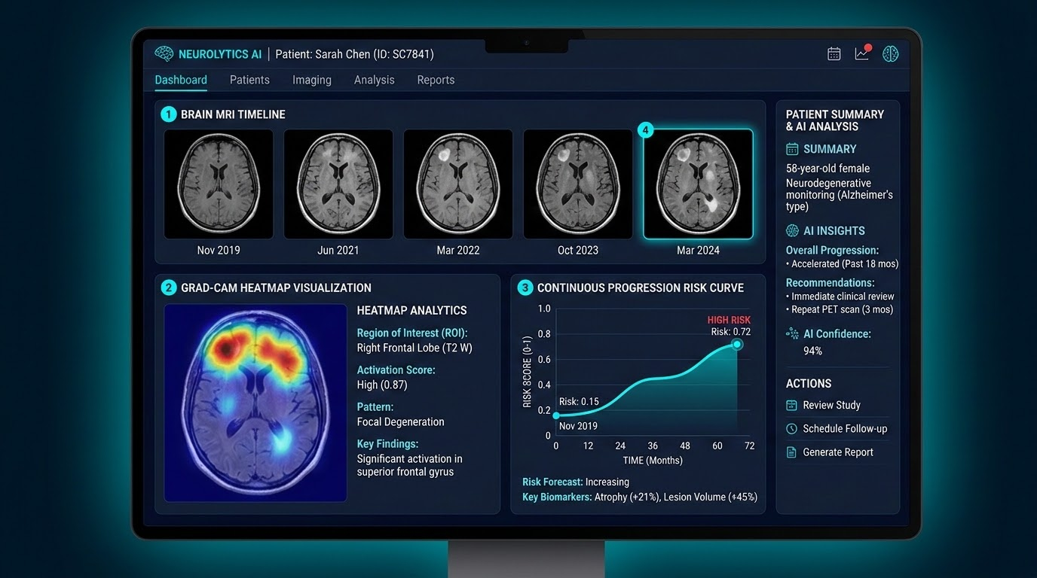
End-to-End Clinical Workflow
From OASIS-2 Raw MRI Scans to Interactive AI Progression Dashboard
ARCHITECTURE & PIPELINE FLOW
STEP 01
OASIS-2 MRI
Data validation & preprocessing of raw scans
STEP 02
3D CNN Model
Brain feature representation extraction
STEP 03
Temporal Model
Longitudinal sequence & progression risk
STEP 04
Explainability
Grad-CAM heatmaps & visual model maps
FINAL OUTPUT
Clinician Dashboard
Integrated review & AI insights interface
SYSTEM INTEGRATION & OUTPUTS
Comprehensive Dashboard Capabilities
Longitudinal MRI Timeline: Serial brain scan tracking across patient historical visits.
Grad-CAM Visualizations: Heatmaps identifying superior frontal gyrus focal degeneration.
Risk Trend Curves: Continuous predictive trajectories for neurodegenerative disease.
Actionable AI Insights: Biomarker metrics (atrophy %, lesion volume) for research & clinical review.

Slide 6




Longitudinal Pattern Analysis Over Static Classification
Core Differentiators
Conventional Approach
Single-Scan Static Classification
Longitudinal Analysis
Utilizes multiple MRI observations across patient visits instead of isolated snapshots.
Single MRI
Static Model
Binary Output
Visit 1
No Temporal Context
High / Low Risk
Temporal AI
Models how extracted structural features evolve dynamically over time.
Progression Output
Estimates a continuous progression risk trajectory rather than static binary outputs.
NeuroPredict AI Paradigm
Multi-Visit Continuous Trajectory & Grad-CAM XAI
MRI 1
Continuous Risk Trajectory
t = 0
Explainable AI (Grad-CAM)
Integrates region-of-interest visualizations to highlight critical disease markers.
Grad-CAM ROI
Temporal AI
Risk Level
MRI 2
Feature
t = +6m
Evolution
Trajectory View
Provides clinicians with an intuitive, transparent, and actionable risk trend over time.
MRI 3
Time (Visits)
t = +12m
Paradigm Shift: Tracks clear, explainable temporal trends across patient history rather than isolated static moments.

Slide 7
48-Hour Execution Roadmap
A realistic 5-phase timeline to deliver the NeuroPredict prototype
Phase 1 • Hours 0–8
Dataset Setup & MRI Preprocessing: Establish initial pipelines and prepare environment data.
Phase 2 • Hours 8–20
Feature Extraction: Build baseline CNN feature extractor and prepare longitudinal scan sequences.
Phase 3 • Hours 20–32
Temporal Modeling: Implement and train temporal model architectures using held-out dataset splits.
Phase 4 • Hours 32–40
Explainability & Timelines: Generate clinical explainability visualizations and temporal projection graphs.
Phase 5 • Hours 40–48
Dashboard & Final Demo: Complete Streamlit dashboard integration, testing, and demo prep using PyTorch & Google Colab GPUs.

Slide 8
Empowering Stakeholders with Structured Progression Insights
CLINICIANS
Structured Visuals
Provides clinicians with structured visualizations of longitudinal MRI-derived patterns.
RESEARCHERS
Progression Framework
Offers researchers a robust framework for studying disease progression over time.
HEALTH SYSTEMS
Data Organization
Supports healthcare systems in organizing complex longitudinal progression data effectively.
PATIENTS & CAREGIVERS
Informed Monitoring
Potentially enables better-informed monitoring and care management journeys.
Prototype Performance Evaluation Metrics
ACCURACY
To Be Measured
PRECISION
To Be Measured
RECALL
To Be Measured
F1-SCORE
To Be Measured
ROC-AUC
To Be Measured
LONGITUDINAL / CALIBRATION
To Be Measured
Note: Clinical usefulness and deployment will require future validation on independent, clinically representative datasets.

Slide 9




Expanding Beyond the Prototype
Toward Multimodal Clinical Integration & Future Scalability
01. EXPANSION
Multimodal AI
Integrates MRI scans with cognitive assessments & clinical variables.
04. SCALE
Larger, Diverse Datasets
Enhanced demographic diversity & refined temporal modeling.
CORE FOUNDATION
Current MVP: Longitudinal MRI
Single & multi-timeframe structural MRI feature extraction and trajectory modeling engine.
02. PRIVACY & GOVERNANCE
Federated Learning
Privacy-preserving decentralized training across institutional silos.
05. PRECISION
Personalized Trajectories
Individualized disease progression forecasts & risk scoring.
03. WORKFLOW
Direct EHR Integration
Seamless clinician-facing record systems & decision support.
06. RIGOR
External Validation
Multi-center external validation & prospective clinical trials.

Slide 10




“Don't Just Analyze the Scan. Understand the Change.”
PROBLEM
Static Snapshots
Alzheimer's progression changes over time; single MRI scans only provide isolated snapshots of a dynamic disease.
SOLUTION
Temporal Modeling
NeuroPredict AI solves this by analyzing longitudinal MRI-derived features using deep learning and temporal modeling.
VISION
Longitudinal Story
Deliver an interpretable research prototype that transforms repeated MRI observations into a clear, understandable progression trajectory.
Thank You
NeuroPredict AI — Understanding the Longitudinal Story of the Brain

